Slide 1
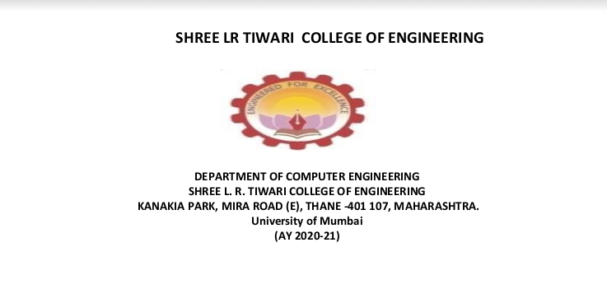
Group Unique ID: AY21TECSM50115
Group Members :- 56_Singh_Pooruvi (Leader)
27_Kini_Aditya
32_Maurya_Suraj
59_Tendolkar_Omkar
Guide:- Neelam Kulkarni

Slide 2
Car and House price prediction web application

Slide 3
Table Of Content
01
02
03
04
05
06
07
08
09
10
11
12
13
Introduction
Problem statement
Motivation
Objective
Literature Review
Proposed System
Requirements
Feasibility Study
Scope of the project
Limitation
Application
Block Diagram
Use case diagram

Slide 4
Table Of Content
14
15
16
17
18
19
20
21
22
23
24
Sequence Diagram
Activity Diagram
Linear regression
Lasso regression
Ridge regression
Sample GUI
Model Implementation
PERT chart
Conclusion
References
Thankyou

Slide 5
Introduction
The used car market is an ever rising industry with the emergence of the online portals such as cars24 ,Quikr and many others has facilitated the need for both the customer and seller to be informed about the trends and pattern that determines the value of the used car in market. The price of a new car is fixed by manufacturer so the customers are assured of the money they invest but for used cars there is a need of system that predicts the worthiness of car using variety of features. Similarly Real estate is the least transparent industry in our ecosystem. Housing prices keep changing day in and day out and sometimes are hyped rather than being based on valuation hence to even tackle this there is a requirement of a predictive model which predicts the value of housing property based on various factors.

Slide 6
Problem Statement
To Develop Machine Learning model that predicts the resale value of used cars on the basis of various factors like Name, Company, Year, Kilometers driven, Fuel-type and value of housing properties on the basis of factors like Area, Location, No of bedroom, New or resale, various amenities and facilities etc.

Slide 7
MOTIVATION
Bring Transparency to the consumer
To cut the intermediary cost
To decide whether a used car is worth the posted price
To regulate the reselling-item system.

Slide 8
Objectives
To develop a web application that helps users to predict the value of the used cars and housing properties.
To help car dealers better understand what makes a car desirable , it’s important feature in order to provide better services.
To predict the efficient house pricing for real estate customers by considering number of factors.
To develop the frontend
To develop an interactive client-side interface with the help of technologies like HTML, CSS and JavaScript so that user can see and interact directly
To develop backend
It will help to deploy and integrate our machine learning model with the help of technology like Flask.

Slide 9
Literature Review
Reference Paper | Authors | Journal / Conference and year | Algorithm and Tool used | Observations and Results
Prediction of Prices for Used Car by Using Regression Models | Nitis Monburinon, Prajak Chertchom Thongchai Kaewkiriya, Suwat Rungpheung, Sabir Buya, Pitchayakit Boonpou . | 2018 5th International Conference on Business and Industrial Research (ICBIR), Bangkok, Thailand | Gradient Boosted regression tree, Random forest,multiple linear regression | Gradient boosted regression trees gave the highest performance with only MAE =0.28. Followed by random forest regression with 0.35 errors, and multiple linear regression with 0.55 errors.
Used Cars Price Prediction using Supervised Learning Techniques | Pattabiraman Venkatasubbu, Mukkesh Ganesh | International Journal of Engineering and Advanced Technology (IJEAT) ISSN: 2249 – 8958, Volume-9 Issue-1S3, December 2019 | Lasso regression,Multiple regression,Regression tree | The prediction error rate of all the models was well under the accepted 5% of error. But,the mean error of the regression tree model was found to be more than the mean error rate of the multiple regression and lasso regression models.
Used Car Price Prediction using K-Nearest Neighbor Based Model | K.Samruddhi, Dr R.Ashok Kumar | International Journal of Innovative Research in Applied Sciences and Engineering (IJIRASE) Volume 4, Issue 2, August 2020 | K nearest neighbour algorithm | It has 85% accuracy, Root-Mean Squared Error (RMSE) rate of 4.01 and Means Absolute Error (MAE) rate of 2.01 with K value of 4.

Slide 10
Literature Review
Reference Paper | Authors | Journal / Conference and year | Algorithm and Tool used | Observations and Results
House Resale Price Prediction Using Classification Algorithms | P. Durganjali, M. Vani Pujitha | IEEE 6th International Conference on smart structures and systems ICSSS 2019. | . In this paper, the resale price prediction of the house is done using different classification algorithms like Logistic regression, Decision tree, Naive Bayes and Random forest are used . AdaBoost algorithm for boosting up the weak learners to strong learners. | The accuracy of logistic regression is 81.4 %and accuracy of decision tree is highest that is 92 %
House Price Prediction Using Regression Techniques: A Comparative Study | CH.Raga Madhuri, Anuradha G, M.Vani Pujitha | IEEE 6th International Conference on smart structures and systems ICSSS 2019. | The paper involves predictions using different Regression techniques like Multiple linear, Ridge, LASSO, Elastic Net, Gradient boosting and AdaBoost Regression. | This article mainly concentrates on the comparison between different machine learning algorithms and among all algorithms gradient boosting has high accuracy value Here the [MSE] Mean Square Error and [RMSE] Root Mean Square Error are used in in order to calculate the accuracy value of the algorithm. It has a score of 0.9177022, MSE of 12037006088.27804,RMSE of 109713 90390
HOUSE PRICE FORECASTING USING MACHINE LEARNING | ALISHA KUVALEKAR, SHIVANI MANCHEWAR, SIDHIKA MAHADIK, SHILA JAWALE | Proceedings of the 3rd International Conference on Advances in Science & Technology (ICAST) 2020 | Decision tree regressor | The accuracy of the model obtained was 89%

Slide 11
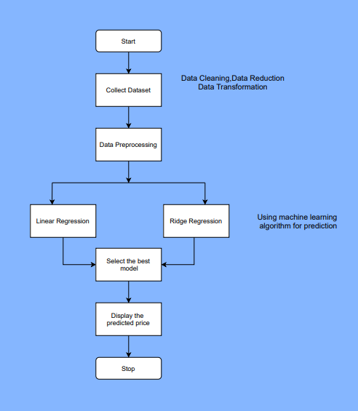
Proposed System
House Prediction

Slide 12
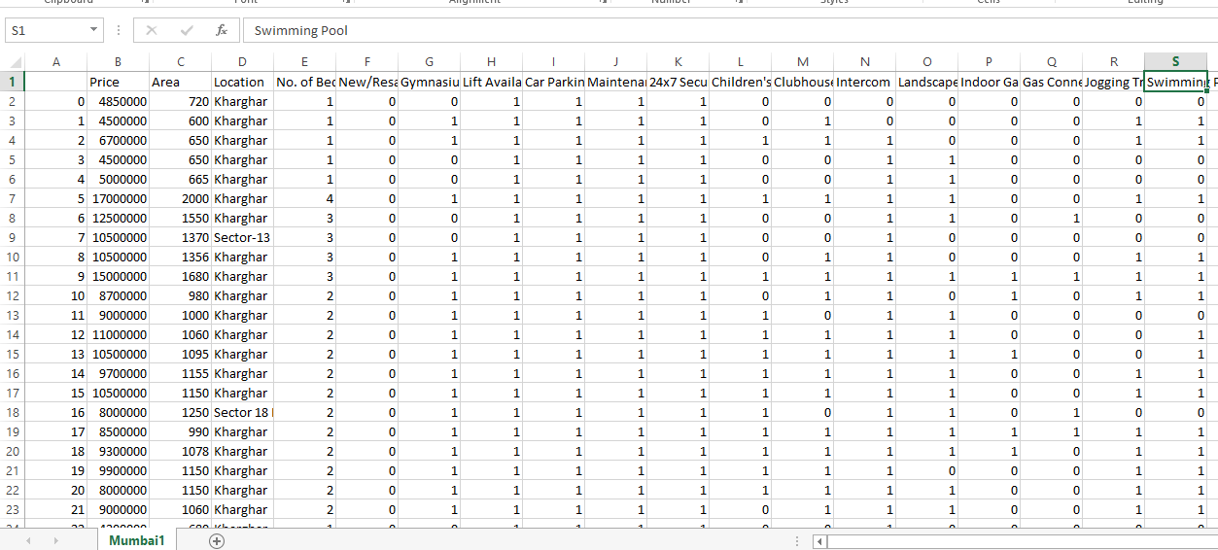
Snap shot of House dataset
The attributes are
a) Area
b) Location
c) Number of Bed rooms
d) New/Resale
e) Gymnasium
f) Lift Available
g) Car parking
h) Maintenance
i) 24x7 security
j) Children play area
k) Club house
l) Intercom
m) Landscaped gardens
n) Indoor games
o) Gas connection
p) Jogging track
q) Swimming pool

Slide 13
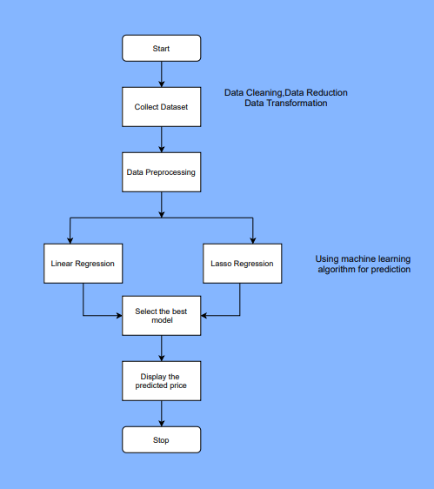
Proposed System
Car Prediction

Slide 14
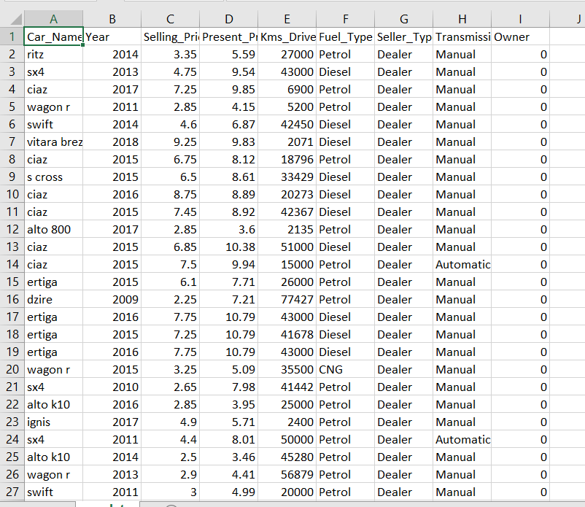
Snap shot of Car dataset
The attributes are
Name
Year
Kilometers driven
Fuel
seller type
Transmission
Owner

Slide 15
Requirements
Hardware
User End:
Any android or IOS smartphone ,tablets PCs or Desktop
Developer End:
The Minimum system requirement
Operating System: Windows 8 or later 64-bit Ubuntu 14.04+, Debian 8+, openSUSE 13.3+, or Fedora Linux 24+
Processor: Intel Pentium 4 or later
Memory:2 GB minimum 4GB recommended
Screen resolution:1280x1024 or larger
Software
Frontend technologies:
HTML CSS
Bootstrap
Backend Technologies:
Flask
JavaScript
Jupiter Notebook

Slide 16
Feasibility Study
Financial Feasibility : As it is a Web Application this system does not require any amount of financial investment . The financial requirements would be for the following :
Domain name .
Hosting .
AWS cloud storage .
Technical Feasibility : House and car price prediction is a complete web application build using ML , HTML , CSS , JS ,JS Node and many more . All the apis are properly functional and the response time is less than 2 seconds . maximum features related to this feature are achieved using these technologies.
Resources Feasibility : Resources that are required for the house and car price prediction project includes programing device(laptop), Hosting space (freely available) , programming tools(free available).

Slide 17
Feasibility Study
Time Feasibility : Project developed plan Prepaired according to availability of number of week and hours/week in the bi-semester.
Social Feasibility : No commission charges excepts the taxes, maintenance , and the other cost required for the website
Risk Feasibility : As it is an web based application there is an risk of corrupting and interferance of the virus which may slow down the web application and crash the hosting .

Slide 18
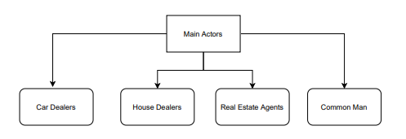
Scope Of The Project
Main cases associated :
Real estate agents : Evaluation of their properties
Car dealers : Evaluation of their cars
Common man : Evaluation of their car and house

Slide 19
LIMITATIONS:
In order to have more robust prediction there is need to gather more data over period of time and there could be more features that can be good predictor for car price prediction like number of doors, color, mechanical and cosmetic reconditioning time.

Slide 20
Application
Social:
The Model will Eliminate the need of intermediaries determining the price and people will be assured of the price they are paying or getting for their property or cars.
Commercial:
The model can be used by various organizations and ventures that provides services like buying and selling to customers in a whole new revolutionized way.
Industrial:
This will help automobile industries to manipulate the design of the cars, the business strategy etc. to meet certain price levels. It will help budding automobile industries to enter into market and understand various factors affecting the automobile price.

Slide 21
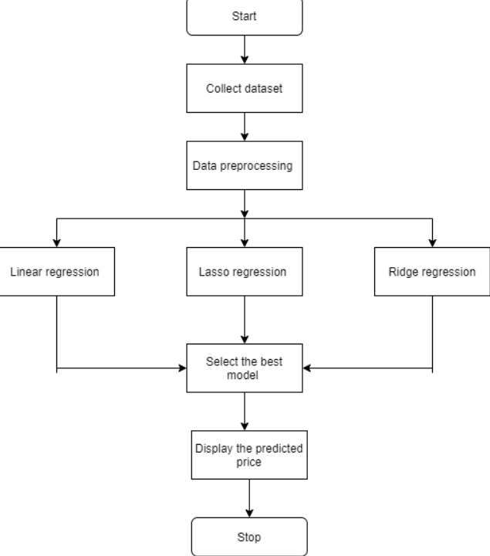
Block Diagram

Slide 22
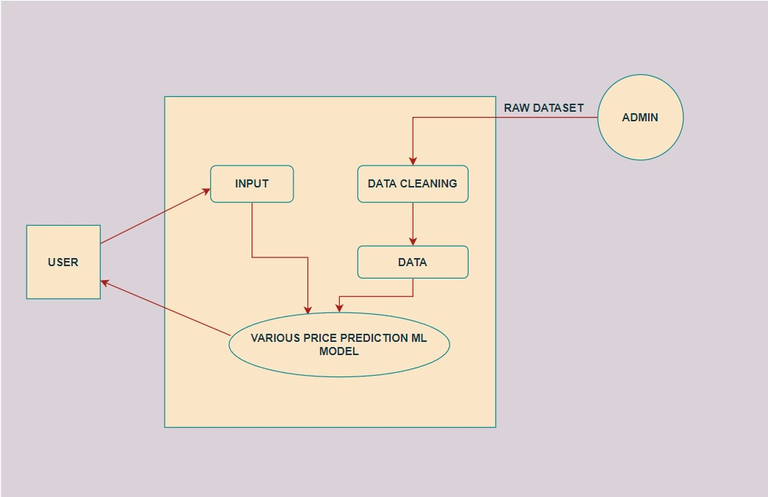
Use Case Diagram

Slide 23
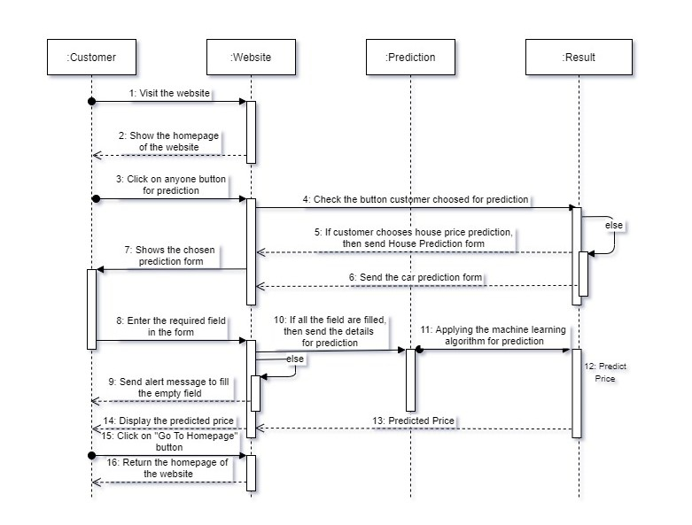
Sequence Diagram

Slide 24
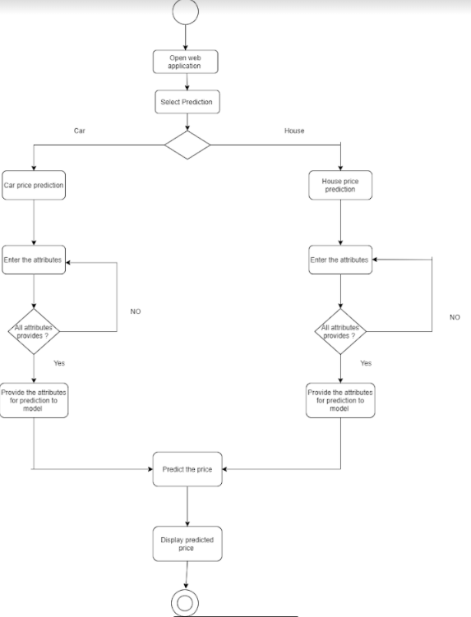
Activity Diagram

Slide 25
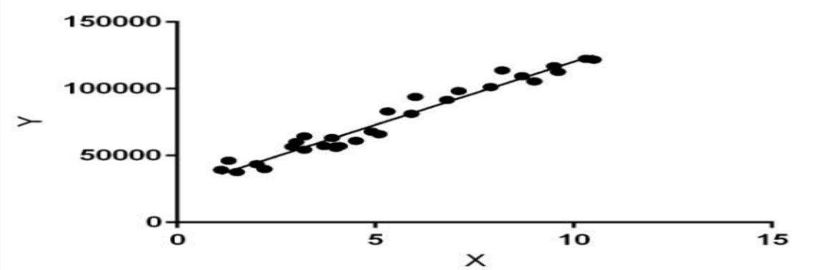
Linear Regression
Linear Regression is a machine learning algorithm based on supervised learning. It performs a regression task. Regression models a target prediction value based on independent variables. It is mostly used for finding out the relationship between variables and forecasting. Different regression models differ based on – the kind of relationship between dependent and independent variables, they are considering and the number of independent variables being used.

Slide 26
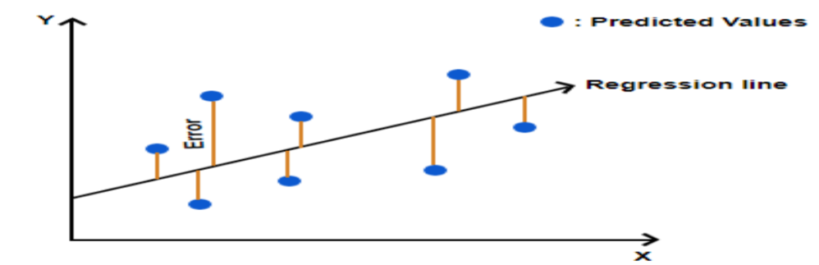
Lasso Regression
Lasso regression is a regularization technique. It is used over regression methods for a more accurate prediction. This model uses shrinkage. Shrinkage is where data values are shrunk towards a central point as the mean. The lasso procedure encourages simple, sparse models (i.e. models with fewer parameters).

Slide 27
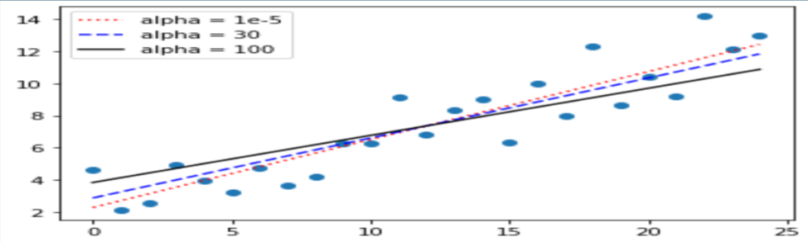
Ridge Regression
Ridge regression is a model tuning method that is used to analyze any data that suffers from multicollinearity. This method performs L2 regularization. When the issue of multicollinearity occurs, least-squares are unbiased, and variances are large, this results in predicted values to be far away from the actual values.

Slide 28
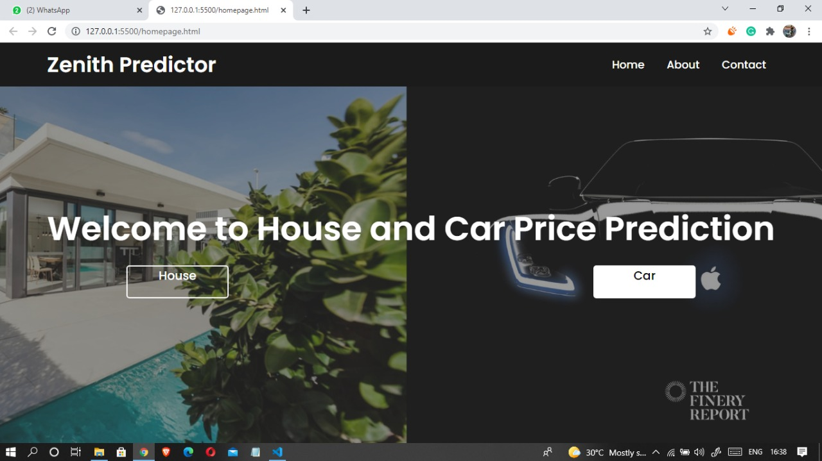
Sample GUI – Home Page

Slide 29
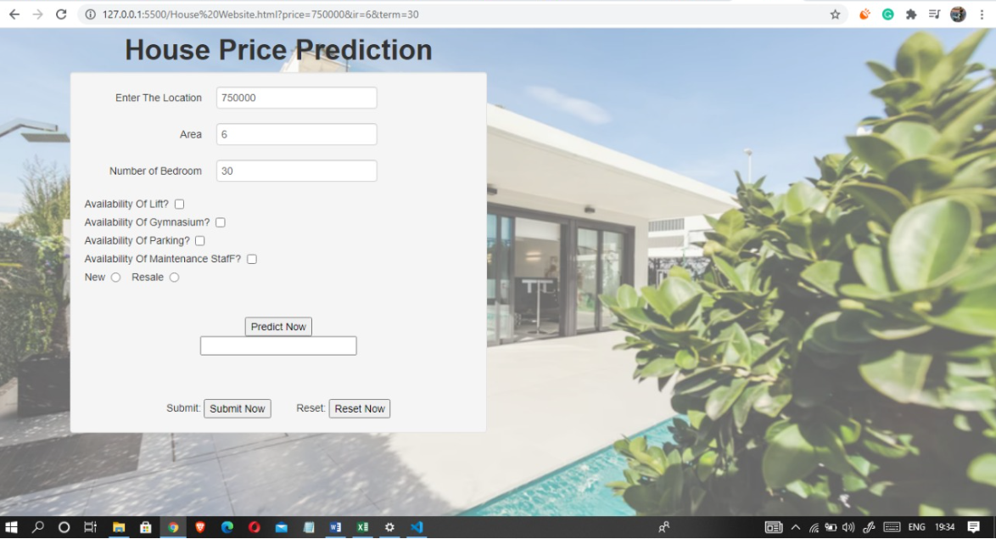
Sample GUI-House Price prediction

Slide 30
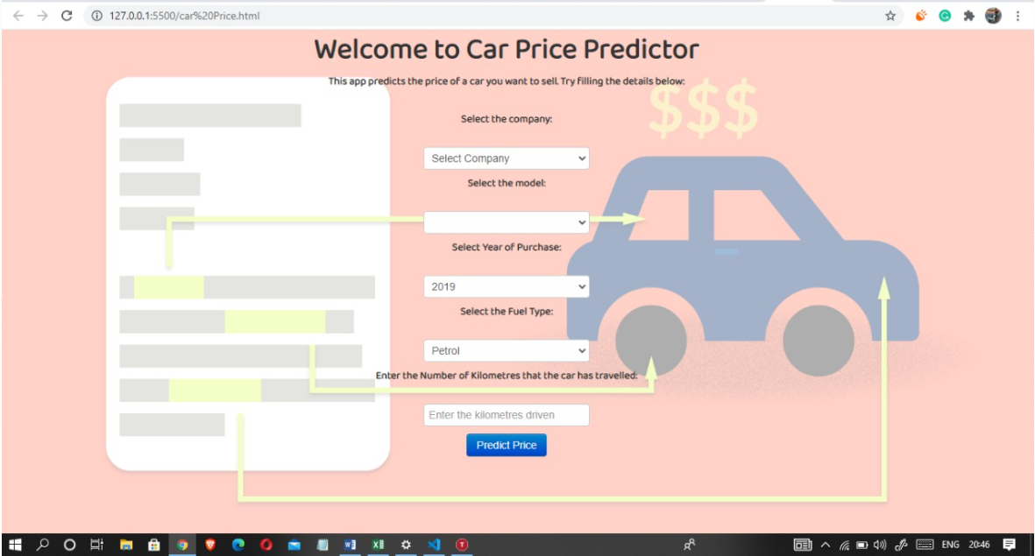
Sample GUI-Car Price Prediction

Slide 31
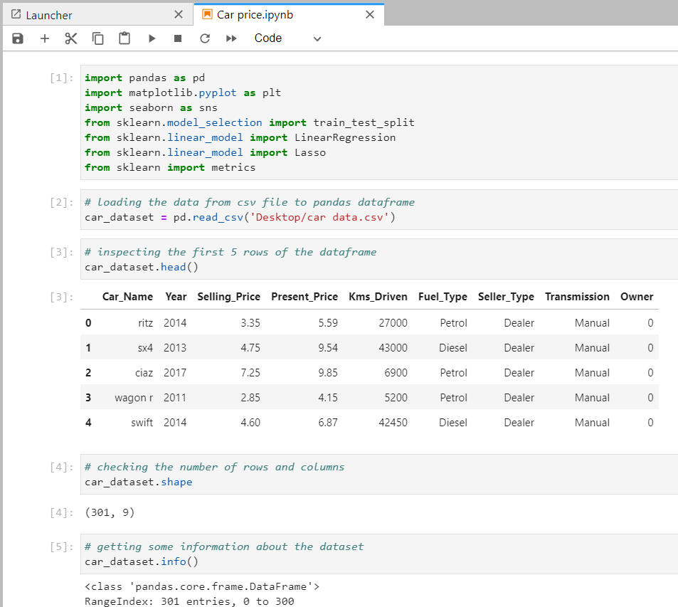
Model Implementation Of Car Price Prediction

Slide 32
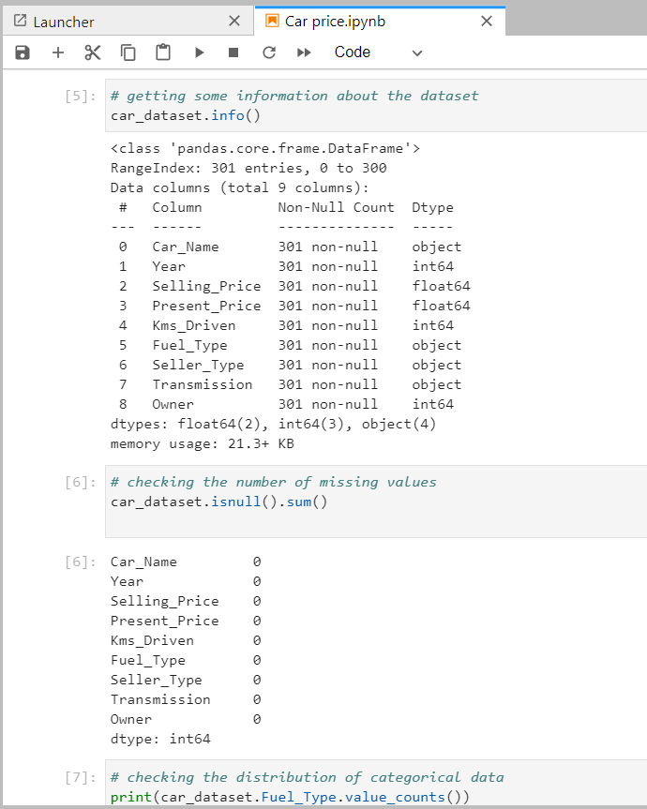
Model implementation Of Car Price prediction

Slide 33
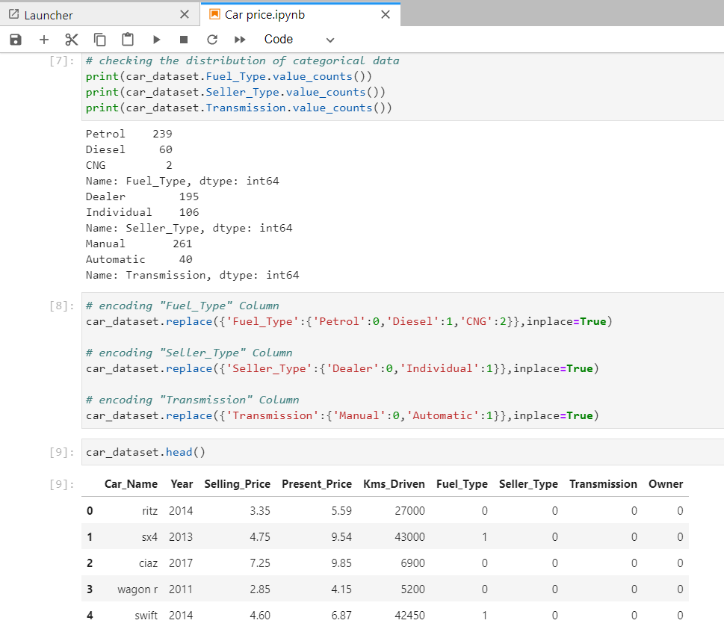
Model implementation Of Car Price prediction

Slide 34
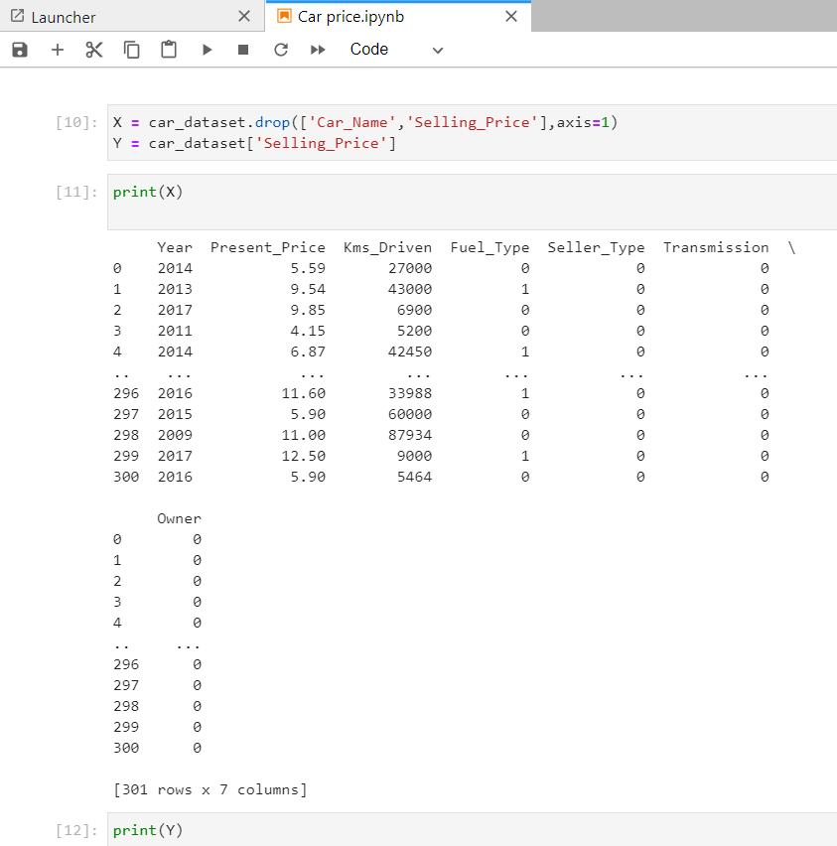
Model implementation Of Car Price prediction

Slide 35
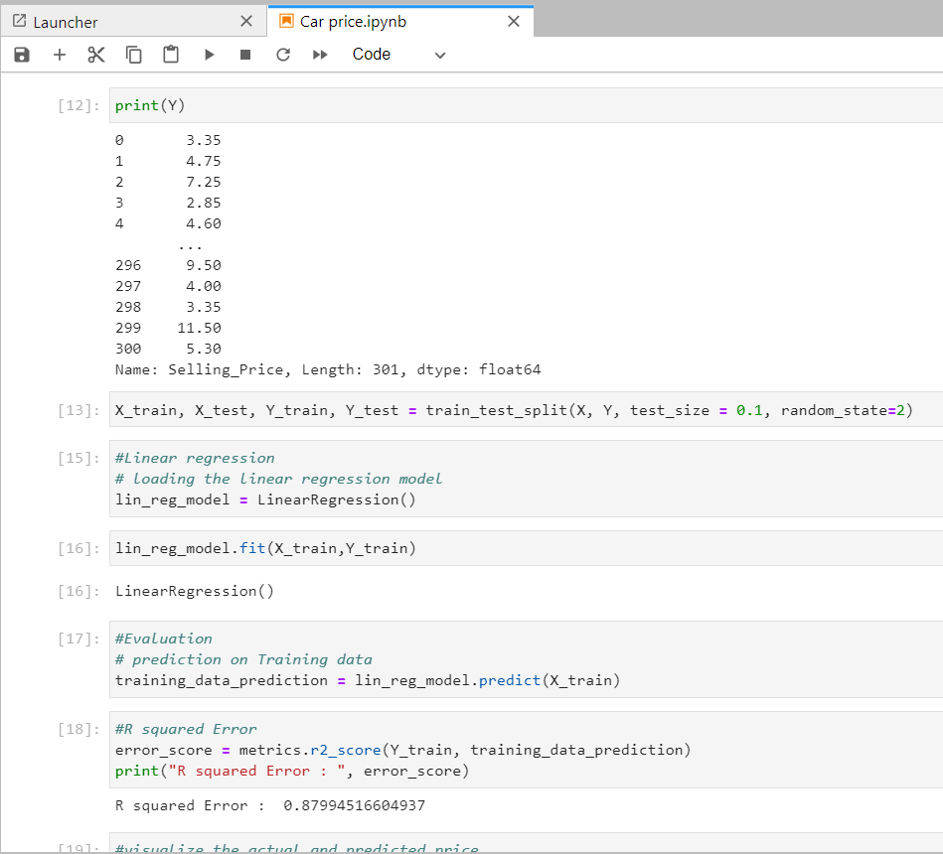
Model implementation Of Car Price prediction

Slide 36
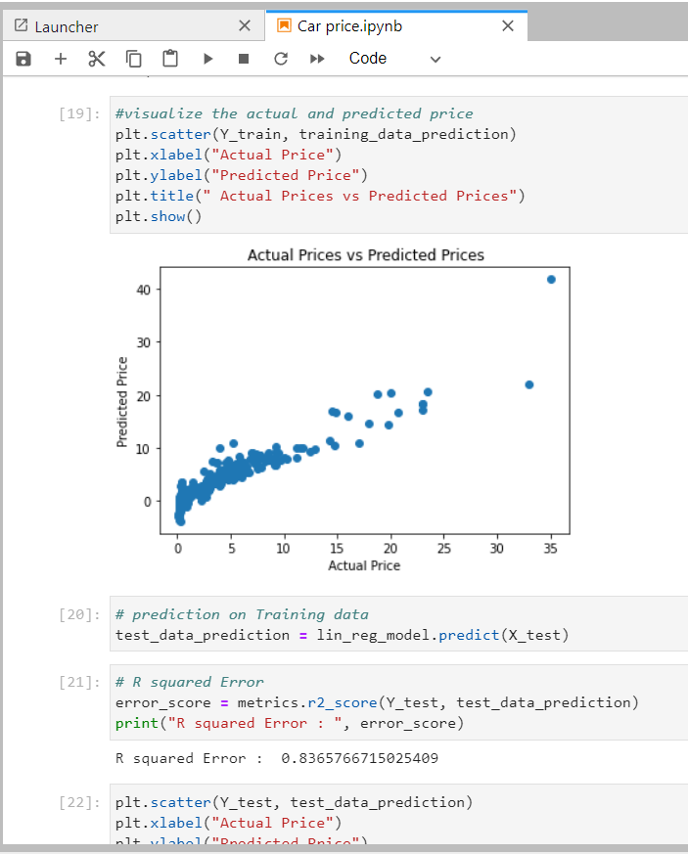
Model implementation Of Car Price prediction

Slide 37
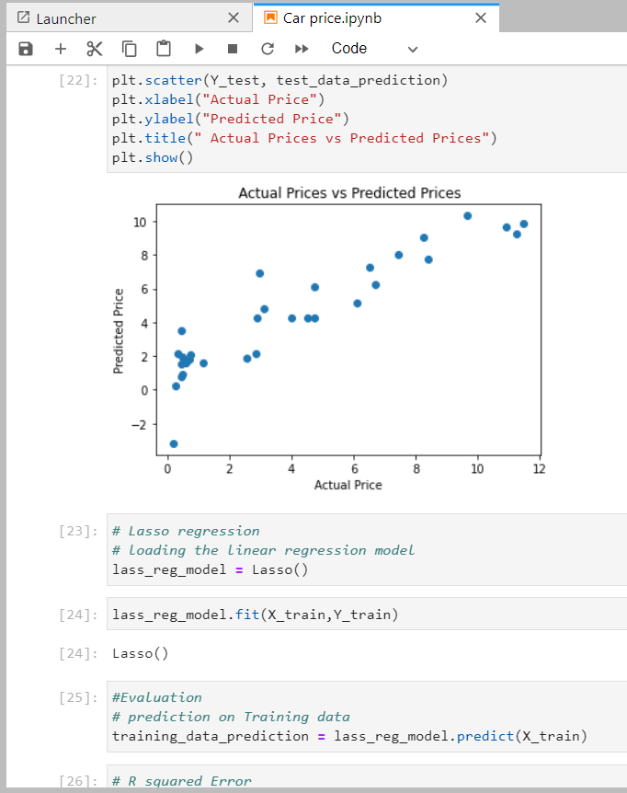
Model implementation Of Car Price prediction

Slide 38
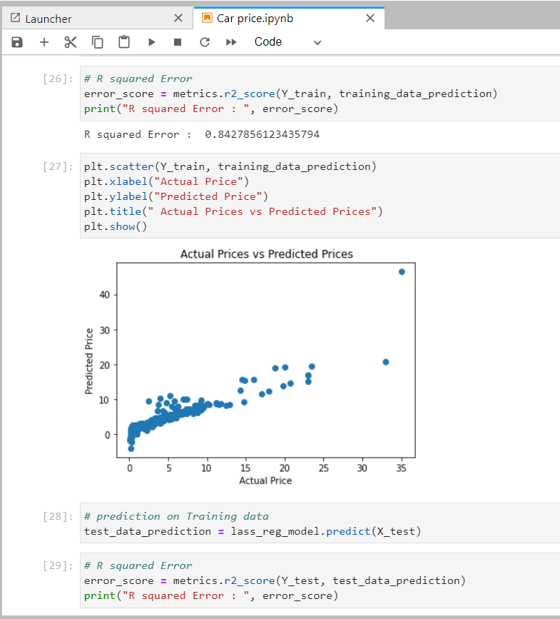
Model implementation Of Car Price prediction

Slide 39
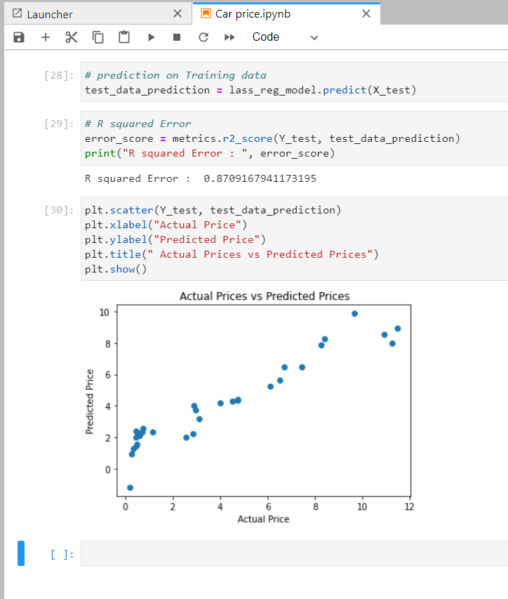
Model implementation Of Car Price prediction

Slide 40
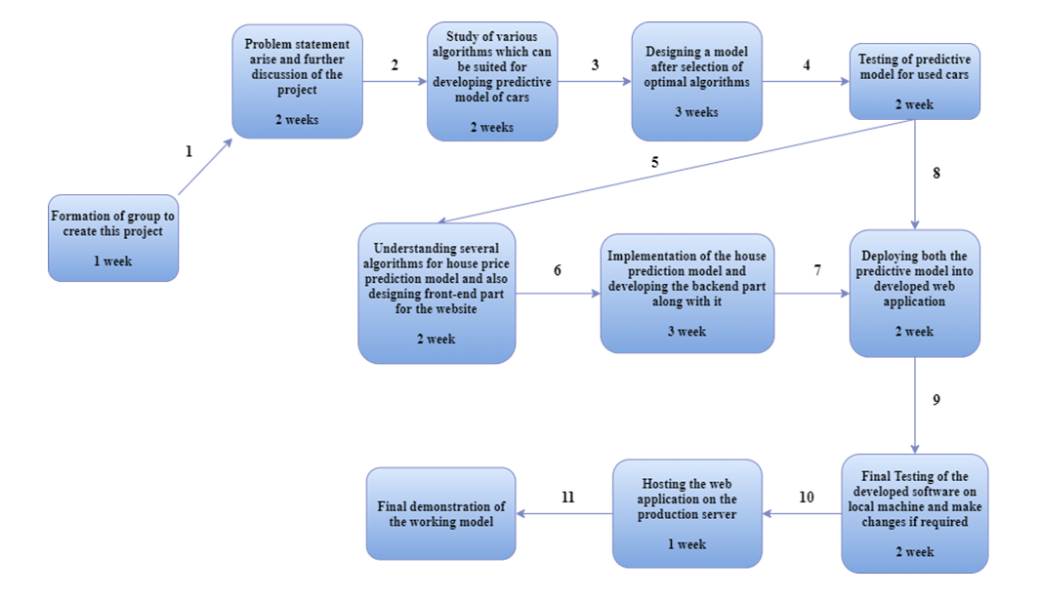
Pert Chart

Slide 41
CONCLUSION:
A car and House price prediction system has been proposed Which helps user's to evaluate the best resale value of their cars and value of their housing properties considering number of factors providing users with assurance and transparency

Slide 42
References
https://towardsdatascience.com/predicting-house-prices-with-linear-regression-machine-learning-from-scratch-part-ii-47a0238aeac1
https://www.sciencedirect.com/science/article/pii/S1877050920316318
https://www.ijert.org/real-estate-price-prediction
https://www.analyticsvidhya.com/blog/2021/07/car-price-prediction-machine-learning-vs-deep-learning/
https://towardsdatascience.com/predicting-car-price-using-machine-learning-8d2df3898f16
https://www.irjet.net/archives/V8/i4/IRJET-V8I4278.pdf
https://www.turcomat.org/index.php/turkbilmat/article/download/6435/5333
https://www.researchgate.net/publication/344099603_Employing_Machine_Learning_for_House_Price_Prediction

Slide 43
Thank You!!!

